Slide 1

Spelling Practice Application With Feedback
By
Muhammad Bin Khalid
Ahmad Arshad

Slide 2
Application Overview
Purpose
Target Audience
Improve spelling skills through interactive practice sessions
Students, individuals looking to enhance spelling accuracy

Slide 3

Spelling Practice Functionality
1
Start Practice
2
Word List
Initiates a spelling session with customizable settings
Practice words from a predefined list or a custom list
3
Feedback
Provides immediate feedback on spelling accuracy

Slide 4



Adding New Words
Add Word
Save List
Users can add new words to the practice list
Persists the custom word list for future sessions

Slide 5




Deleting Words
Select Word
Users can choose a word from the list to remove
Confirm Deletion
Confirmation prompt to prevent accidental removals
Update List
The updated word list is reflected in the application

Slide 6
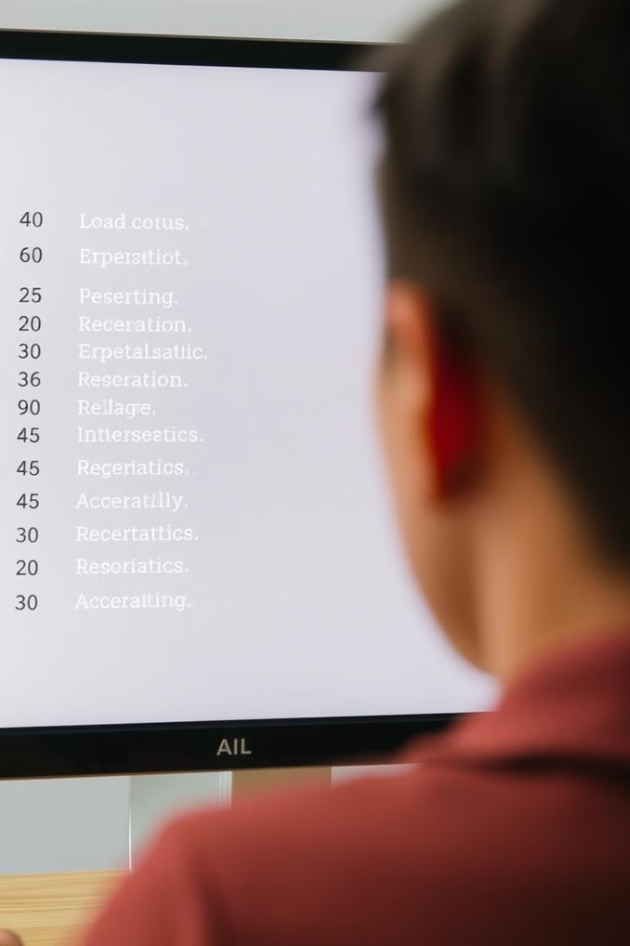
Viewing Word List
Display Options
Word Count
Show words in alphabetical order or random order
Displays the total number of words in the list

Slide 7

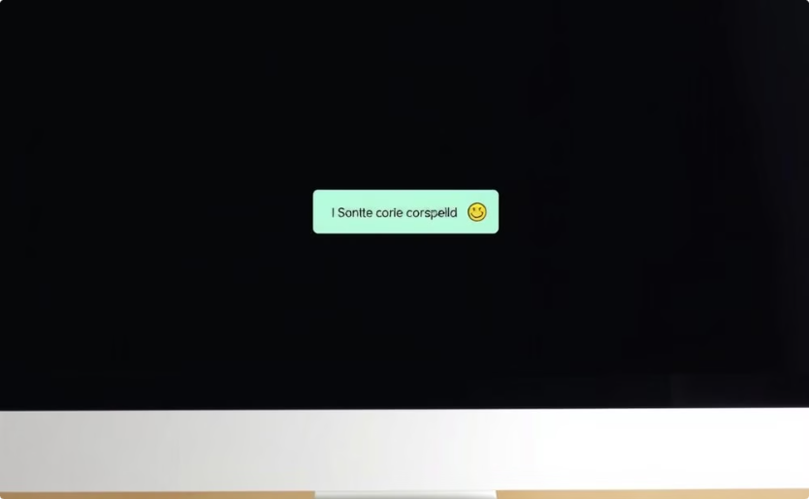
User Interface Design
Keyboard Input
Visual Feedback
Easy and accessible input method for typing words
Immediate feedback on spelling accuracy, clear and concise messages

Slide 8




Conclusion and Next Steps
1
Future Enhancements
Expand Word Lists
2
Include different themes and difficulty levels
Sound Effects
3
Add audio feedback for a more immersive experience
Gamification
4
Introduce points and achievements to motivate users

